Slide 1
Mid Project Review
MSiA Yi Feng

Slide 2
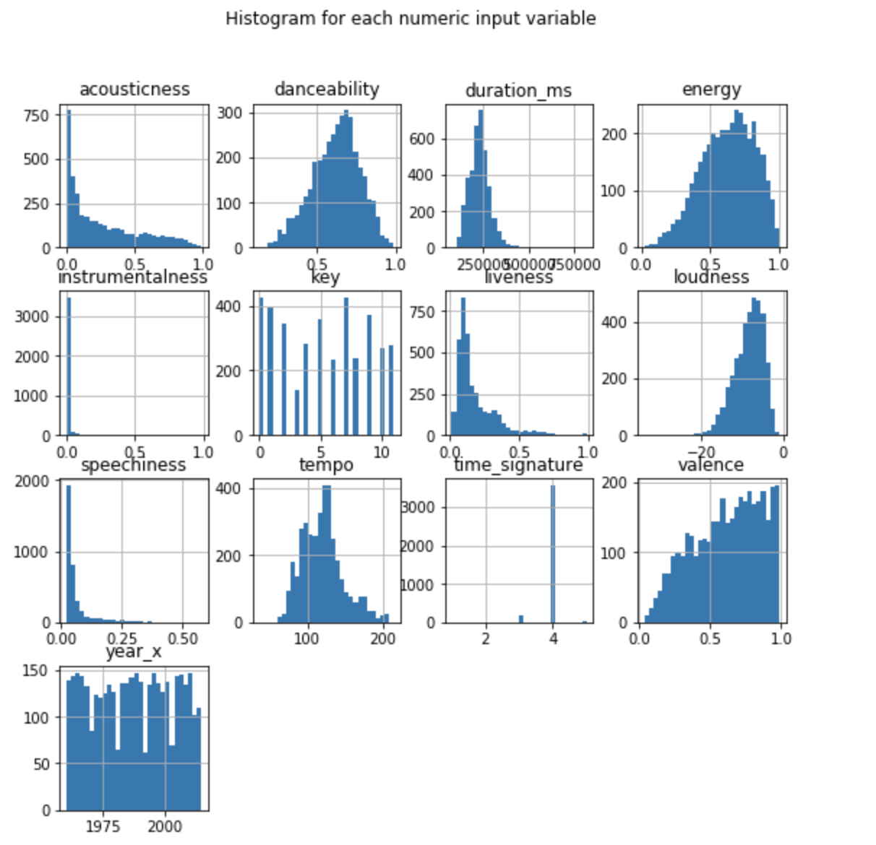
Highlights
Finished the Data Preparation for the modeling
After merging data sources, there are 5027 rows of observations, 14 potential predictors and 2 potential response variables
Initial EDA and modeling
Histogram of Numeric Predictors

Slide 3
Highlights
Modeling
Build several regression models based on the response variable “popularity” which is computed as 1/(Billboard rank)
Build several classification models based on the binary response variable “rank” which is computed as
1 if rank is less or equal to 25
0 if rank is greater than 25

Slide 4
Review Progress
Finish up to Epic 2 Story 1
Backlog
Story 1: Merge databases (4 point)
Online datasets searching
Merge several datasets to include more features of songs that will be needed for modeling
Story 2: EDA (2 point)
Explore the potential variables that could be used to better predict the songs' popularities
Perform necessary variables transformation
Epic 2: Modeling Build the predicting models such as linear regression, neural networks and etc. Choose the optimal model by the ML metrics.
Backlog
Story 1: Build initial models (4 points)
Build several predicting models with features from the first epic.
Use common ML metrics and test dataset to choose the final model.

Slide 5
Demo/Analysis
Models for Regression
Random Forest has cross validation training R square as 0.16 and testing MSE of 141.91
Neural Network has cross validation training R square as 0.015 and testing MSE 140.23
Models for Classification
Logistic Regression has cross validation training R square as 0.80 and accuracy of testing data as 0.784
Random Forest has cross validation training R square as 0.80 and accuracy of testing data as 0.784

Slide 6
Lessons Learned
The predictive models do not work well with the dataset
Most of the features about the song do not influence the ranking much
For classification model, the machine learning metrics were satisfying because of unbalanced data
Considering changing the project direction to clustering and recommendation

Slide 7
Recommendation/Next Step
Build clustering models with the dataset
Build recommendation model such as kNN with the clusters
Construct the front end of the web app

